Slide 1


Insight CCTV Face Recognition
Facoltà di Ingegneria dell’informazione, informatica e statistica
Corso di Laurea in Informatica
Biometric Systems
Prof Maria de Marsico
Hazem Dewidar
Riccardo Mancini
Davide Gabrielli
2022/2023

Slide 2
Insight CCTV face recognition

Slide 3



Insight CCTV face recognition
Crowd surveillance
Intrusion detection
Track across cameras
Notes:
Qui parlare delle motivazioni che ci hanno fatto scegliere questo problema

Slide 4
Insight CCTV face recognition
In metros
At an event
At a university
Crowd surveillance
Intrusion detection
Track across cameras
Notes:
Qui parlare delle motivazioni che ci hanno fatto scegliere questo problema

Slide 5
Insight CCTV face recognition
Restricted area of governative building
Restricted area in a company
Or just somebody’s home
Crowd surveillance
Intrusion detection
Track across cameras
Notes:
Qui parlare delle motivazioni che ci hanno fatto scegliere questo problema

Slide 6
Insight CCTV face recognition
See where a person went
Crowd surveillance
Intrusion detection
Track across cameras
Notes:
Qui parlare delle motivazioni che ci hanno fatto scegliere questo problema

Slide 7
The system

Slide 8
The system
SCRFD
ArcFace
Notes:
Qui parlare delle motivazioni che ci hanno fatto scegliere questo problema

Slide 9
The system
SCRFD
ArcFace
Sample Computation Redistribution for efficient Face Detection: it gives us bounding boxes and key points
Notes:
Qui parlare delle motivazioni che ci hanno fatto scegliere questo problema

Slide 10
The system
SCRFD
ArcFace

Slide 11
The system
SCRFD
ArcFace
Deep learning model for face recognition. It uses a special loss function that increases the separation of different classes in the feature space
Notes:
Qui parlare delle motivazioni che ci hanno fatto scegliere questo problema

Slide 12
The system
SCRFD
ArcFace
The main idea is to use a model that, given two faces, it would simply tell whether they are from the same person or not.
Notes:
Qui parlare delle motivazioni che ci hanno fatto scegliere questo problema

Slide 13
The system
SCRFD
ArcFace
Face Detector
Face recognition
1
Detection
Tracking
Identification
Notes:
ù

Slide 14
The system
SCRFD
ArcFace
Face Detector
Face recognition
Detection
Tracking
Identification
2
Notes:
ù

Slide 15
The system
SCRFD
ArcFace
Face Detector
Face recognition
Detection
Tracking
Identification
3
Notes:
ù

Slide 16
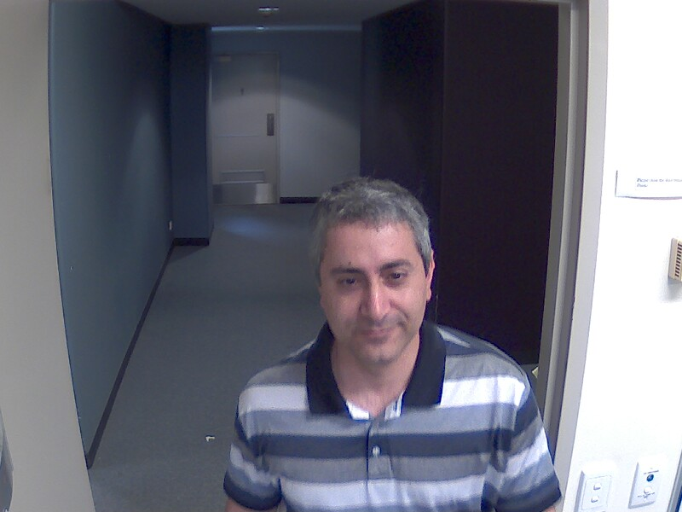
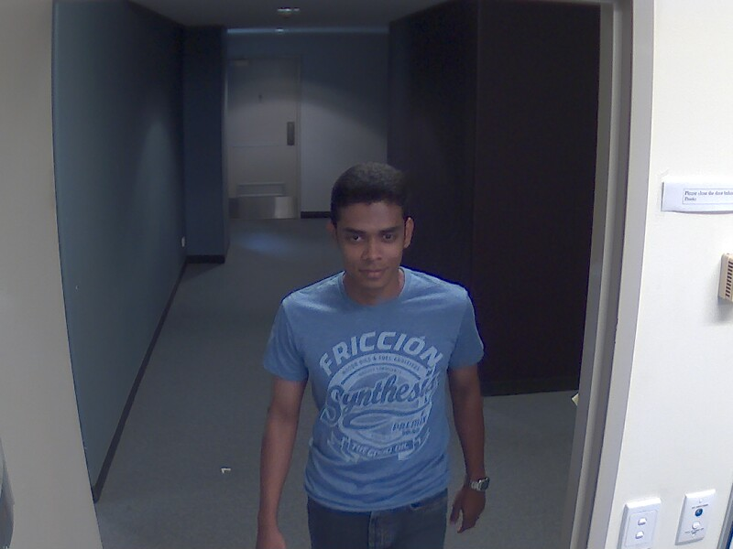

The system
Detection
Tracking
Identification
SCRFD
Notes:
ù

Slide 17
The system
Detection
Tracking
Identification
SCRFD
Notes:
ù

Slide 18
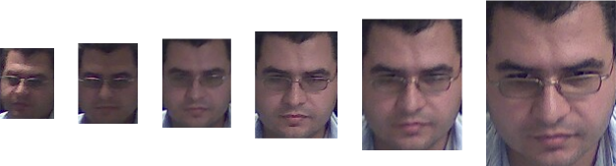
The system
Detection
Tracking
Identification
ID X
Notes:
ù

Slide 19
The system
Detection
Tracking
Identification
ID X
Notes:
ù

Slide 20
The system
Detection
Tracking
Identification
ID X
Notes:
ù

Slide 21
The system
Detection
Tracking
Identification
ID X
Notes:
ù

Slide 22
The system
Detection
Tracking
Identification
ID X
Notes:
ù

Slide 23
The system
Detection
Tracking
Identification
ID X
Notes:
ù

Slide 24
The system
Detection
Tracking
Identification
Notes:
ù

Slide 25
The system
Detection
Tracking
Identification
Notes:
ù

Slide 26
The system
Detection
Tracking
Identification
Notes:
ù

Slide 27
The system
Detection
Tracking
Identification
SUBJECT OUT OF FRAME
BEST FRAME SELECTION
COMPARING WITH GALLERY
ASSIGN AN IDENTITY
Notes:
ù

Slide 28
The system
Detection
Tracking
Identification
If the subject has left the scene for more than a certain number of frames then proceed to identify them
SUBJECT OUT OF FRAME
BEST FRAME SELECTION
COMPARING WITH GALLERY
ASSIGN AN IDENTITY
Notes:
ù

Slide 29
The system
Detection
Tracking
Identification
The system takes the frame with the biggest bounding box
SUBJECT OUT OF FRAME
BEST FRAME SELECTION
COMPARING WITH GALLERY
ASSIGN AN IDENTITY
Notes:
ù

Slide 30
The system
Detection
Tracking
Identification
The system takes the frame with the biggest bounding box
SUBJECT OUT OF FRAME
BEST FRAME SELECTION
COMPARING WITH GALLERY
ASSIGN AN IDENTITY
Notes:
ù

Slide 31
The system
Detection
Tracking
Identification
For each template in the gallery, take the top match idenitity and check whether it’s above the threshold. For this purpose, we use the cosine similarity.
SUBJECT OUT OF FRAME
BEST FRAME SELECTION
COMPARING WITH GALLERY
ASSIGN AN IDENTITY
Notes:
ù

Slide 32
The system
Detection
Tracking
Identification
We fuse the results of each image using a score level using as measure the similarity score.
Otherwise, we label the subject as unknown/intruder
SUBJECT OUT OF FRAME
BEST FRAME SELECTION
COMPARING WITH GALLERY
ASSIGN AN IDENTITY
Notes:
ù

Slide 33
The system in action

Slide 34
Evaluation

Slide 35
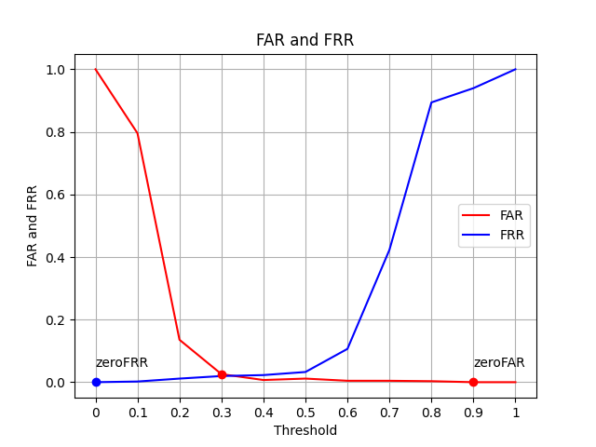
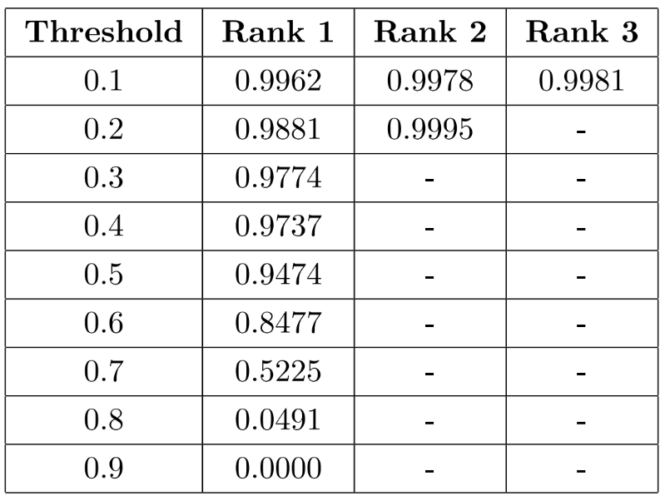
Evaluation

Slide 36
Evaluation

Slide 37
Evaluation
0.3 threshold
FAR
FRR
0.4 threshold
0.5 threshold
0.6 threshold

Slide 38
Evaluation
0.3 threshold
FAR
FRR
0.4 threshold
0.038
0.023
0.5 threshold
0.6 threshold

Slide 39
Evaluation
0.3 threshold
FAR
FRR
0.4 threshold
0.009
0.026
0.5 threshold
0.6 threshold

Slide 40
Evaluation
0.3 threshold
FAR
FRR
0.4 threshold
0.009
0.053
0.5 threshold
0.6 threshold

Slide 41
Evaluation
0.3 threshold
FAR
FRR
0.4 threshold
0.006
0.152
0.5 threshold
0.6 threshold

Slide 42
Conclusions and future work

Slide 43
Conclusions and future work
Better frame selection policy, maybe using a deep model like faceQnet
Add an antispoofing system
Improving the image quality through techniques of computer vision
Expand the tracking module to enable not only the tracking through the face but also using other elements as cloth and gait

Slide 44
Thank you for your attention

Slide 45
Questions?

